Slide 1
Hennepin County Freight Study Committee
Final Recommendations
Hennepin County Public Works
Elaine McKenzie
Andreas Aeppli
December 1, 2016

Slide 2
Agenda
Welcome and Introductions
Freight Study Overview
Key Study Findings
Recommendations

Slide 3
Freight Study Overview

Slide 4
Freight Study Goals
How does freight move in Hennepin County
  What are the primary origins, destinations, routes, and clusters of freight and freight-generating activity?
Identify key trends in freight activity
  Who is using the system now, and what changes can be expected in the future?
How does the County’s freight system perform
  What actions can the County take to support efficient freight movement?

Slide 5
Freight Study Scope and Schedule
Task 1
Infrastructure and Network Use
June, 2016
Task 2
Commodity Flow Analysis
August, 2016
Task 3
Truck System Performance
October, 2016
Final
Findings and Recommendations
December 2016

Slide 6
Key Study Findings

Slide 7
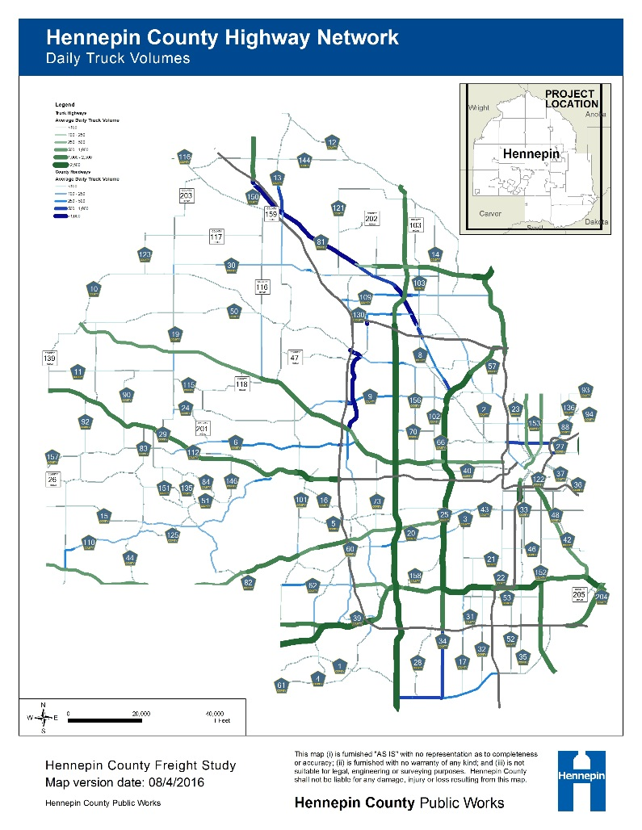
Use of the County Freight System - Highways
Trucks move 83 percent of goods in Hennepin County, by weight
Provide first- and last-mile connections.
Heavy county road volumes:
  Routes that parallel key state/interstate routes (61 and 81)
  Lake Minnetonka area (15, 19, and 110)

Slide 8
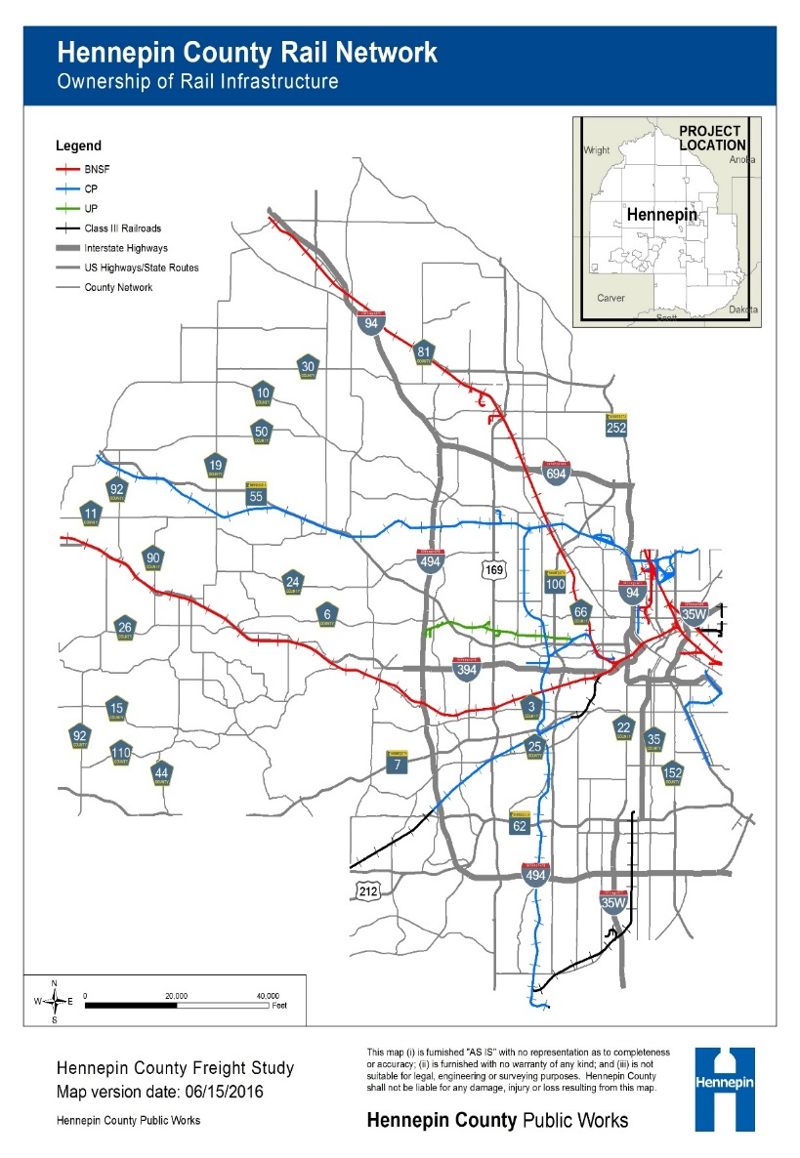
Use of the County Freight System - Rail
172 track miles of freight rail infrastructure in Hennepin County
  90 percent owned by CP, BNSF, and UP
  Mainly through traffic
CP’s Humboldt and Shoreham railyards both served partially by County roadways
Notes:
Humboldt is served by CSAH's 152, and CSAH 57. Shoreham is partially served by CSAH 153, and CSAH 23

Slide 9
Use of the County Freight System – Policy Concerns
Primarily national or state issues
  Labor shortages
  Safety regulations
  Truck size and weight limitations
  Truck Tolling
Key local concern is de-industrialization of the urban core.
  Increasing development pressure
  “Highest and best” land use
  Mis-match between residents and jobs

Slide 10
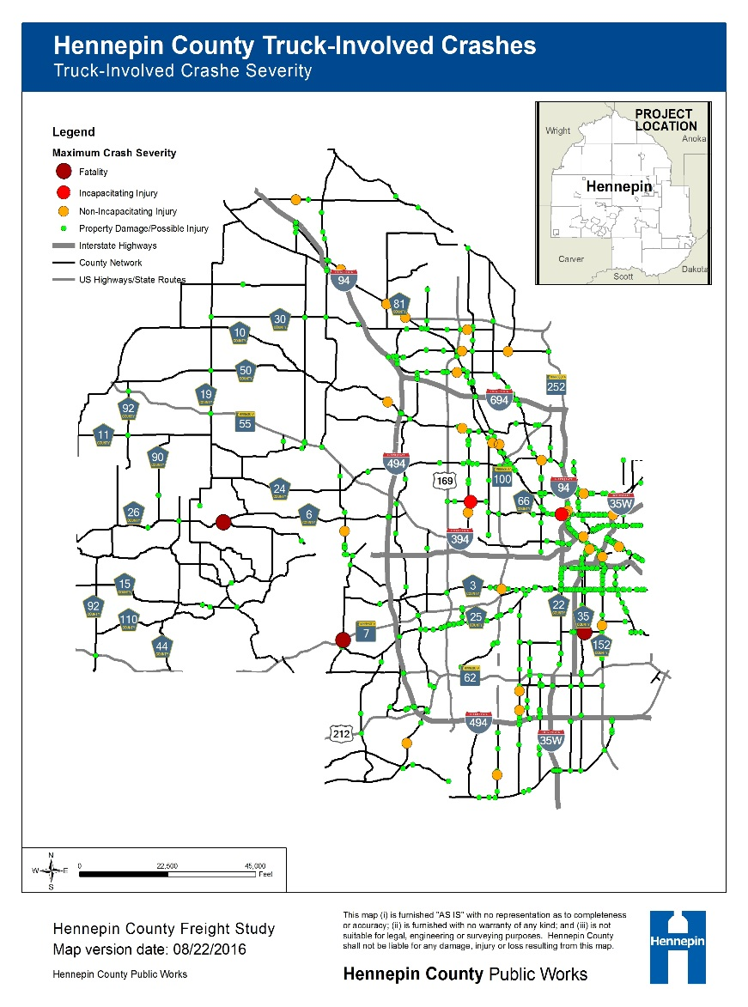
Safety – Truck Crashes
893 truck-involved crashes on County Highways (2010 – 2014)
  3 fatalities and 208 persons injured
Crash rates similar to the state as a whole
Fatalities:
  6 (6th Ave) and 112 (Wayzata Blvd)
  101 and TH 7
  46 (East 46th Street) and 33 (Park Ave)

Slide 11
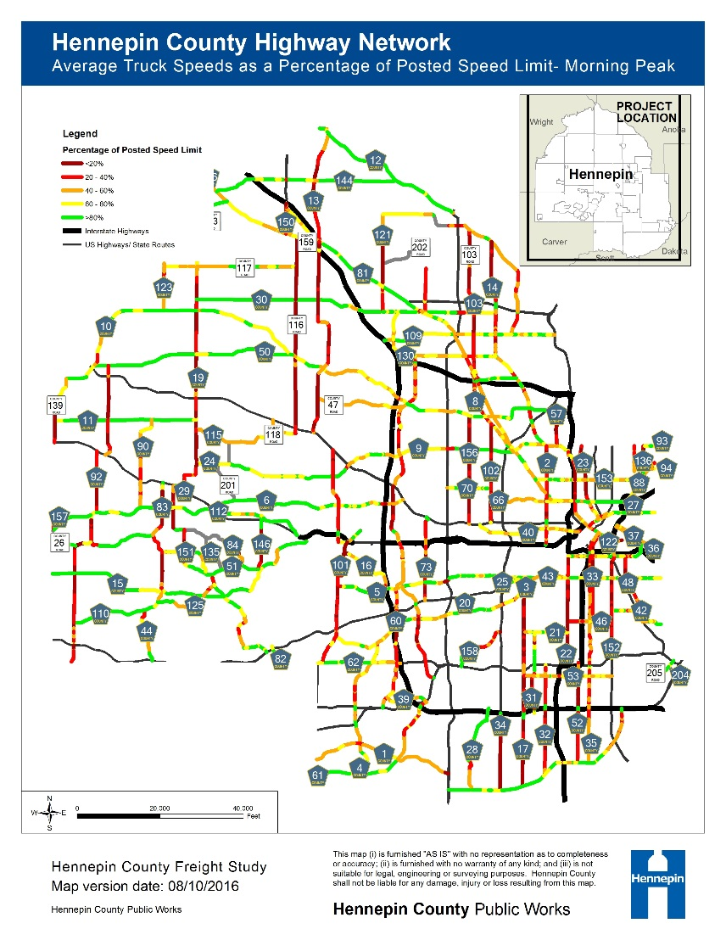
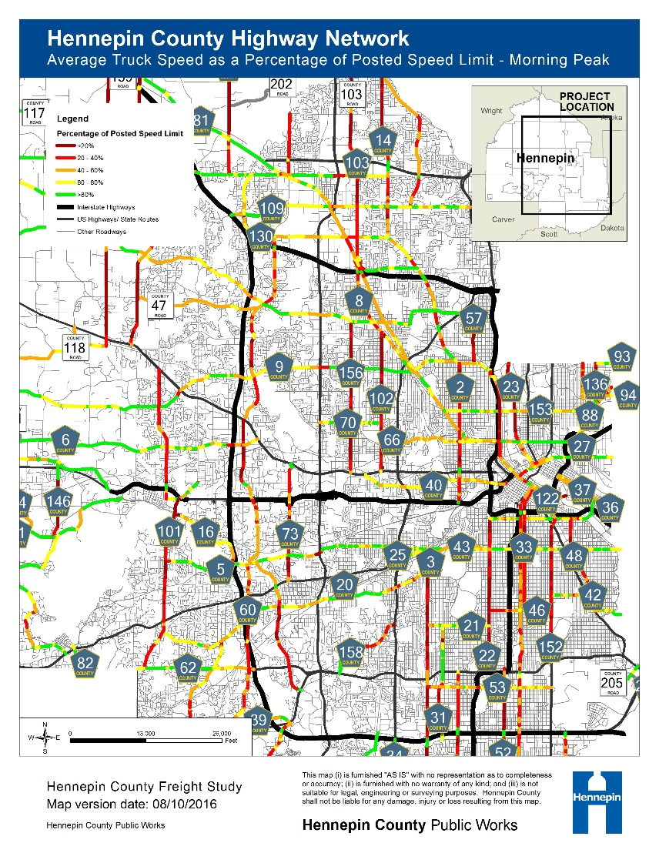
Areas of Heavy Freight Activity on the County Highway Network
Notes:
Roadways outside of the County’s urban core, generally west of I-494, exhibit higher average truck speeds than those in congested areas.
The worst performing roadway was CR 116 which had average truck speeds of 6 and 7 mph during the morning and evening peak periods, respectively.
Allow time for discussion

Slide 12
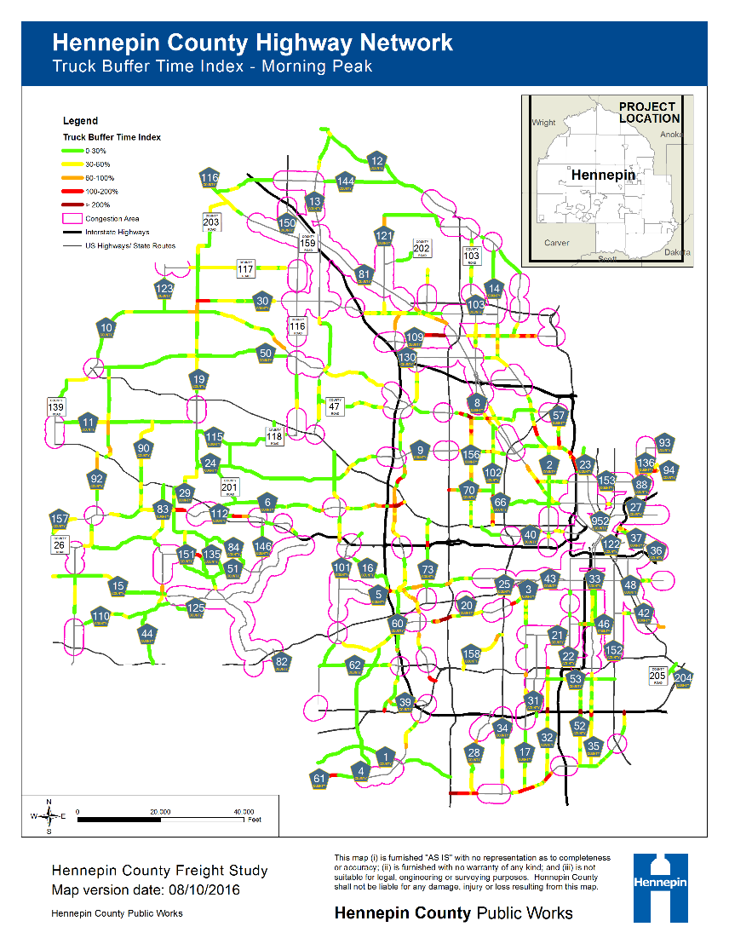
Truck Congestion on the County System
Truck congestion occurs both with and separate from general congestion areas
Reliability issues:
  High truck congestion on County Roadways 109, 9, 61, 1
  Congestion around major intersections –
    9 and U.S. 169
    61 and I-494
    61 and CSAH 9 / TH 55
    81 and I-94, TH 610 and U.S. 169.

Slide 13
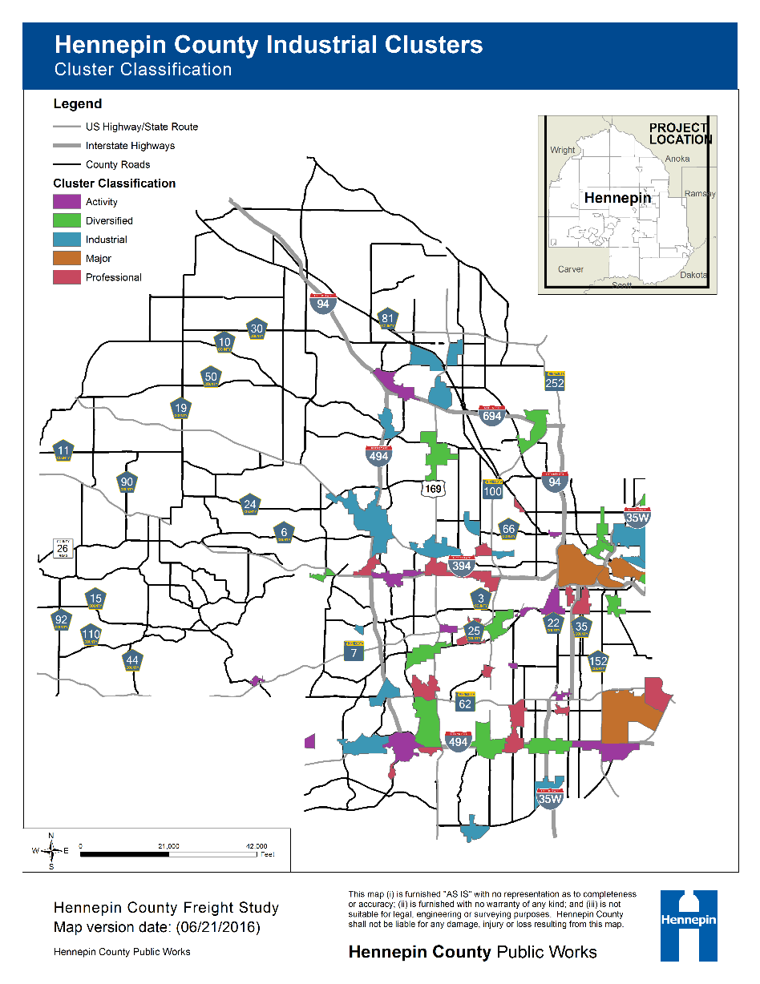

Areas of Freight Activity
59 economic clusters (DEED)
Industrial employers comprise 1,500 firms and 57,000 employees in the County
Number of Employees by Cluster Type
Source: Minnesota DEED

Slide 14
Freight Intensive Industries
No. Businesses in Hennepin County by Industry
No. Employees in Hennepin County by Industry
Source: Dun and Bradstreet Hoover’s Business Data (2014)
Notes:
Top Manufacturing Businesses: Honeywell International (8 facilities in County and 9,544 employees – consumer products
Graco Inc. (9 facilities and 2,194 employees – fluid handling systems – manufacturing equipment
Top Wholesale Businesses: Cargill, Inc. (7 facilities and 3462 employees);
Ziegler Inc (1 facility and 790 employees) (Caterpillar equipment)
Top Retail Businesses: Supervalu Inc (13 facilities and 1628 employees),
Bluestem Fulfillment Inc (3 facilities and 905 employees) – 16 e-commerce retail brands,
Top Transportation/Warehousing Businesses: United Parcel Service (2 facilities and 3544 employees),
Supervalu Transportation (2 facilities and 2591 employees)

Slide 15
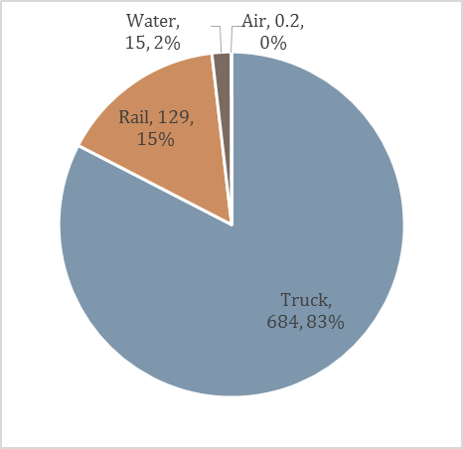
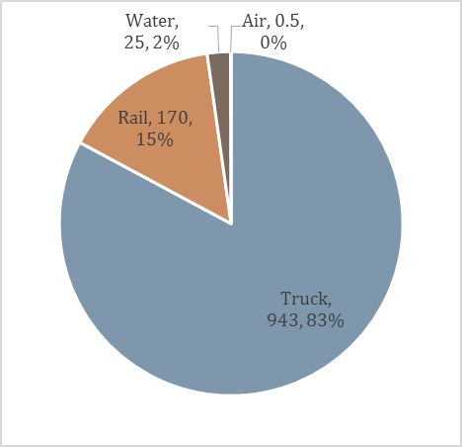
Hennepin County Total Tonnage Projected to grow 33% by 2040
Mode Share by Tons (in millions of tons)
2014
2040 (Projected)
828 million tons
1.1 billion tons
Notes:
Includes through traffic
HC growth rate 1.2 percent a year
Relatively stable mode mix

Slide 16
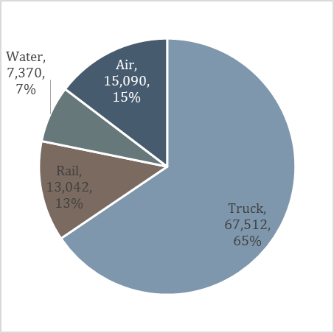
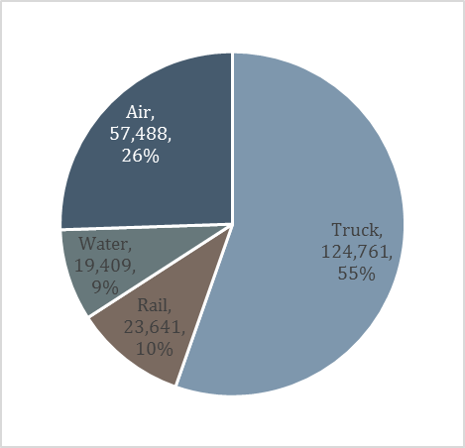
Hennepin County Freight Value Projected to Grow by 118%
Mode Share by Value (in millions of dollars; excluding through traffic)
2014
2040 (Projected)
$103 billion
$225 billion
Notes:
HC annual growth rate 3.1 percent
69 million tons 2014

Slide 17
Top Trading Partners
Top Domestic Trading Partners by Total Tonnage and Mode, in Millions of Tons, 2014
Rank | Highway |  | Rail |  | Water |  | Air
 | Trade Partner | Tons | Trade Partner | Tons | Trade Partner | Tons | Trade Partner | Tons
1 | Rest of Minnesota | 40 | East North Central (Chicago) | 2 | Louisiana (all FAF Zones) | 8 | Chicago IL-IN-WI (IL Part) | 0.03
2 | Iowa | 5 | West North Central | 1 | Buffalo, New York CFS Area | 4 | Miami, Florida | 0.01
3 | Wisconsin | 5 | Mountain | 0.5 | Iowa | 0.5 | Cleveland, Ohio | < 0.01
4 | East North Central (Chicago) | 3 | Pacific | 0.2 | Los Angeles, CA | 0.5 | Detroit, Michigan | < 0.01
5 | South Atlantic | 1 | West South Central | 0.2 | Chicago, IL-IN-WI (IN Part) | 0.4 | Los Angeles, California | < 0.01

Slide 18
Primary Highway Commodities
Major Highway Commodities, 2014 (million tons)

Slide 19
Recommendations

Slide 20
Key Freight Study Themes
Ensure safety of both freight and passenger transportation within and through the County through targeted policies and investments;
Integrate freight into County planning and project development, creating a culture that promotes efficient, effective, and safe movement of goods;
Monitor performance of the freight transportation system in a way that supports performance-based planning and effective investments;
Cultivate partnerships with public-sector agencies on freight transportation related issues, creating a vehicle to advocate for the County’s needs and contribute to projects benefiting Minnesotans in and out of the County; and
Support economic vitality in Hennepin County through continued outreach, partnership, and support to businesses.

Slide 21
Recommendations Overview
Recommendation | Ensure Safety | Integrate Freight | Monitor Performance | Cultivate Partnerships | Economic Vitality
Identify and Prioritize Freight Projects | X | X | X |  | X
Freight Performance Measures | X | X | X | X
Freight Data |  | X | X | X
Design for Safe Freight Movement | X | X | X | X | X
Support Freight in the Urban Core |  | X |  | X | X
Upgrade Road/Rail Crossings | X | X | X | X
Continue Engaging Freight Stakeholders |  | X | X | X | X
Identify Areas for Future Study | X | X | X | X | X

Slide 22
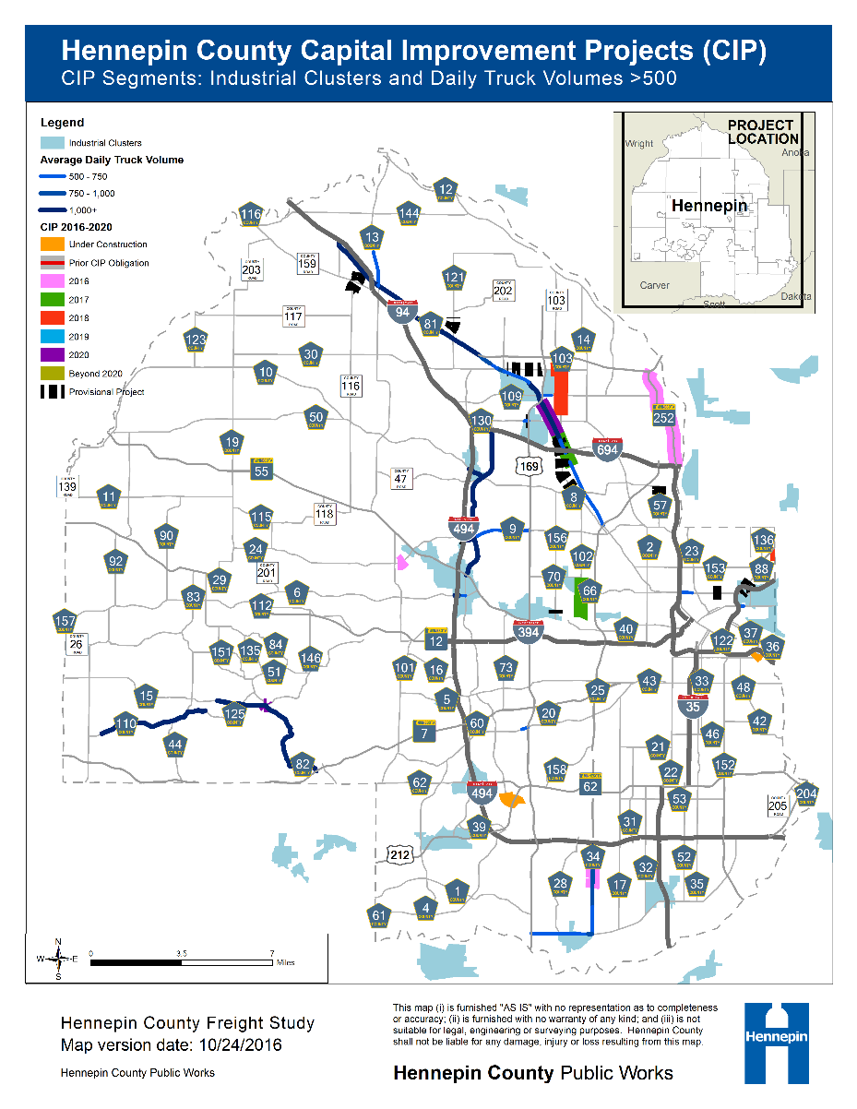
Identify and Prioritize Freight Projects
19 upcoming and 4 completed “freight” projects in 2016 – 2020 CIP
  Within 1 mile of an industrial cluster
  Truck AADT > 500
Notes:
Pull list of projects for reference

Slide 23
Freight Performance Measures
Identify and track freight performance on the County system
  Mobility (truck volumes / congestion)
  System Performance (pavement condition / obstacles)
  Economic Indicators (volumes / value of goods shipped)
  Others…
Specific County measures should:
  Align with ongoing work by MnDOT and MetCouncil
  Track performance on County-owned roadways
  Provide information to support local decision making

Slide 24
Freight Performance Measures
Draft USDOT Freight Performance Measures
  Percent of the Interstate System Mileage providing for Reliablke Truck Travel Times
  Percent of the Interstate System Mileage Uncongested
MnDOT Freight Performance and Economic Indicators:
  Annual Hours of Truck Delay (AHTD)
  Truck Reliability Index (RI80)
  Heavy Commercial Average Annual Daily Traffic (HCAADT), by corridor
  Truck / Rail / Port / Airport volumes and container lifts
MetCouncil Prioarity Performance Measures for TPP(April, 2016)
  Key truck corridors (10 ton corridors)
  Truck travel time index
  Access of rail-accessible industrial land
  Bridge and Pavement Condition
Notes:
MetCouncil for Transportation Policy Plan, May 2016

Slide 25
Freight Data
Collect and maintain freight data on the County system
  Future traffic counters should distinguish heavy trucks
  Prioritize data collection on bridge and infrastructure condition
Coordinate with MnDOT and MetCouncil efforts
    Track freight performance in and around Hennepin County
    Supplement with County level data, as able
Re-study the freight system on a periodic basis
Notes:
Hennepin County should be checking all bridges on significant freight routes for low clearance bridges that may be affecting traffic and flow – might want to also check all bridge heights to see if trucks are getting diverted because of obstructions and lengthening time to get to destination based on changing routes to avoid these – there may be other obstacles or obstructions also that should be looked at on the major routes

Slide 26
Design for Safe Freight Movement
Land Use Conflicts
Design/ Streetscape Conflicts
Transportation Operations Conflicts
“Good neighbor” policies
Plan for increasing truck traffic in growing areas
Intersections that allow safe truck movements
Rumble strips, center guardrails, wider shoulders/ turn lanes
Designated loading zones and parking
Signage and signal timing

Slide 27
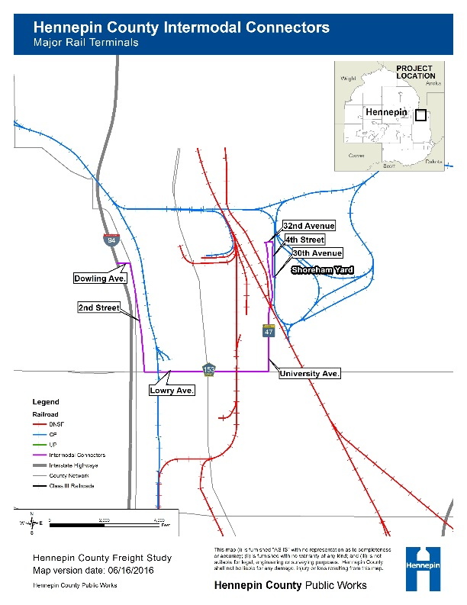
Advocate for Freight Projects
Articulate and support County priorities in MnDOT, MetCouncil planning and programs
NHS Intermodal Connectors
  Shoreham Yard –
    N 2nd Street-N Lowry-University Ave
Notes:
Shoreham
Note Route connecting I94 to Shoreham via N 2nd Street-N Lowry-University Ave is a MAP-21 intermodal connector
South end of Northtown Yard is also accessible by this route. Northern end of Northtown bridges over I694

Slide 28
County Growth Strategy
Freight intensive uses are moving out of the urban core into peripheral regions
    Can cause difficult policy decisions when development forces unplanned infrastructure improvements
    Increases congestion, truck and passenger VMT
    Disconnect between workers and jobs
Top 10 freight bottlenecks are in Hennepin County (MnDOT)
Hennepin County should work with its partner agencies to develop a comprehensive strategy to address these issues

Slide 29
Upgrade Road/Rail Crossings
Inventory road/rail crossings on County roadways with high freight volumes for truck mobility/safety issues, e.g. lane geometry and clearances
Partner with MnDOT and MetCouncil to advance priority road/rail crossing improvements

Slide 30
Continue Engaging Freight Stakeholders in Hennepin County
Businesses in Hennepin County…
  Think it is a good place to do business
  Want better connections to international gateways
  Want alleviation of congestion/freight bottlenecks
  Want a focus on freight as overall growth continues
GreaterMSP, freight-oriented businesses, and business organizations should be periodically engaged by the County
Track long term trends, priorities, and performance

Slide 31
Identify Areas for Future Study
Corridor-level studies of principal freight clusters
  County 61 (Plymouth Road)
  County 116 (Fletcher Lane)
  State Route 100 and 169 (partner with MnDOT / MetCouncil)
Bridge, clearance and sign inventories
Align freight with other planning efforts (within/outside County) and update study peridoically

Slide 32
Concluding Thoughts
Existing industry and freight-related growth provide both economic opportunity and strain transportation resources
Dealing with freight will continue to be a challenge for all transportation agencies
This study provides a foundation for Hennepin County to:
  Plan for and integrate freight into overall processes
  Ensure safe and efficient freight transportation
  Prioritize freight-related investments and programs necessary to support future economic growth
  Increase data collection and monitoring of County roadways
  Coordinate with MnDOT, MetCouncil, and County stakeholders on freight related issues

Slide 33
Discussion and Questions
Thank you!

