Slide 2

Ryan White Program Grant Overview

Slide 3

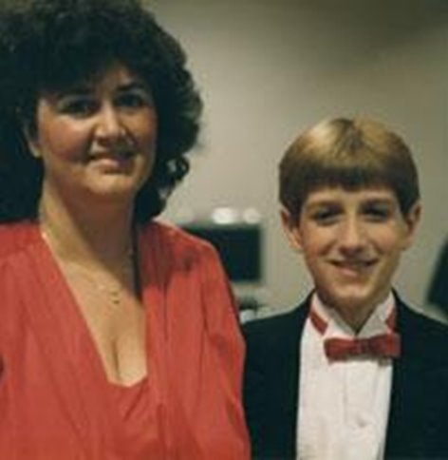
Ryan White
Ryan White was diagnosed with AIDS at the age of 13 following a blood transfusion in December 1984.
He and his family fought AIDS-related discrimination in his Indiana community.
Ryan White and his family rallied for his right to attend school, gaining national attention, and became the face of public education about the disease and its reach.
He died in April 1990, one month before graduating high school and only months before Congress passed the legislation bearing his name in August 1990 - the Ryan White Comprehensive AIDS Resources Emergency (CARE) Act.
Jeanne White Ginder, Ryan White's mother, continues the activism in her son's name.

Slide 4
Ryan White HIV/AIDS Program
Ryan White is the largest Federal government program specifically designed to provide services for people living with HIV/AIDS - $2.6 billion dollars (2023) in Ryan White funding to cities, counties, state and local community-based organizations.
It is the third largest Federal program serving people living with HIV/AIDS - only after Medicaid and Medicare.
It was enacted as the Ryan White Comprehensive AIDS Resources Emergency Act in 1990 – amended in 1996, 2000, 2006, and 2009.
Hennepin County Ryan White Program
Subrecipient onboarding – Grant Overview

Slide 5
Ryan White HIV/AIDS Program
Goals and Expected Outcomes
GOALS
Ryan White consumers/clients will achieve viral suppression through:
Early diagnosis of HIV
Access to and retention in care
Receiving and adhering to treatment (antiretroviral therapies)
Improved health outcomes
Reaching and maintaining viral suppression
EXPECTED OUTCOMES
ACCESS: Ryan White clients will have and maintain access to Core Medical Services.
IMPROVE: Improved health outcomes.
REDUCE: Reduce and/or eliminate Ryan White clients' barriers to access and maintain care and increase treatment adherence.
Hennepin County Ryan White Program
Subrecipient onboarding – Grant Overview

Slide 6
Ryan White Part A Funds
Ryan White Part A funds grants to Eligible Metropolitan Areas (EMAs) and Transitional Grant Areas (TGAs) that are most affected by the HIV epidemic.
Hennepin and the 13 surrounding Counties qualify as a TGA as there are between 1,000 and 1,999 HIV/AIDS cases in the most recent five years.
Hennepin County administers the Ryan White Part A funds to contract with clinic and community-based organizations to provide core medical and support services to low-income people living with HIV.
The Hennepin County Ryan White Program also provides staffing for the Minnesota Council for HIV/AIDS Care and Prevention which plans for the HIV prevention and care services needs of people at risk for or living with HIV/AIDS in Minnesota.
Hennepin County Ryan White Program
Subrecipient onboarding – Grant Overview

Slide 7
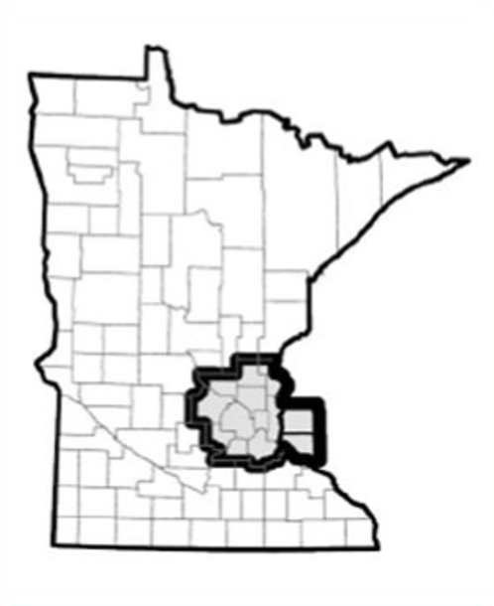
Minneapolis-St. Paul Transitional Grant Area
Part A Funds are granted to 52 metropolitan areas in the United States and Puerto Rico
50% of People living with HIV in Minnesota live in Hennepin County
Hennepin County’s Public Health Clinic is front and center diagnosing 20-25% of Minnesota's HIV cases
83% of Minnesota's HIV prevalence is within the 13-county transitional grant area
Part A Funds serve people living with HIV in 11 Minnesota and 2 Wisconsin counties:
Anoka, MN | Ramsey, MN
Carver, MN | Saint Croix, WI
Chisago, MN | Scott, MN
Dakota, MN | Sherburne, MN
Hennepin, MN | Washington, MN
Isanti, MN | Wright, MN
Pierce, WI

Slide 8

Minority AIDS Initiative
In 1998, HIV/AIDS was the third leading cause of death among Black women and the second leading cause of death among Black men aged 25-44.
The AIDS rate (i.e., the number of people living with AIDS per 100,000 population) among adults and adolescents was 84.7 among Blacks, 37.8 among Hispanics, and 9.9 among Whites.
Spearheaded by African American leaders, including the Congressional Black Caucus, and supported by President Bill Clinton, the federal Minority AIDS Initiative (MAI) came to be in 1998 in response to concerns raised by community advocates about the disproportionate impact of HIV/AIDS on America's racial/ethnic minority populations.
The goal of this initiative was to build the capacity of minority-led organizations to address the disproportionate impact of HIV/AIDS on racial and ethnic minorities.

Slide 9
Part A MAI Funding in the metro TGA
Under Part A, MAI funding provides Outpatient/Ambulatory Health Services and Medical Case Management to improve access and reduce disparities in health outcomes in the Part A Transitional Grant Area.
The priority populations for Part A MAI funding in Minnesota are Hispanic/Latino, Black (African-born and African American), American Indian/Alaska Native.
Hennepin County Ryan White Program
Subrecipient onboarding – Grant Overview

Slide 10
Ryan White Part B/Rebate Funds
Ryan White Part B provides grants to states and territories to improve HIV health care and support services. These improvements relate to quality, availability, and organization.
The Ryan White Part B grant includes a base grant for core medical and support services, a supplemental grant for areas demonstrating need, AIDS Drug Assistance Program (ADAP), and emergency relief funds.
The Minnesota Department of Human Services (DHS) receives Ryan White Part B funding and Hennepin County acts as a pass-through administrative entity, administering some Part B funded core medical and support services in the metro area.
DHS also administers locally generated revenue from the federal 340B pharmaceutical rebate program.
Hennepin County Ryan White Program
Subrecipient onboarding – Grant Overview

Slide 11
Funding Sources and How to Use Them
Part A | Clients must live in the TGA as outlined to the left. For providers receiving both Part A and Part B/Rebate funds, Part A funds are to be expended first.
Part A MAI | Clients must live in the TGA as outlined to the left. Clients must identify as Hispanic/Latino, Black (African-born and African American), and/or American Indian/Alaska Native. For providers receiving both Part A and Part A MAI funds in the same service category, efforts should be made to fully spend MAI funds first.
Part B | Clients must live in the state of Minnesota Funds must reach prioritized populations
Rebate | Clients must live in the state of Minnesota Funds must reach prioritized populations

Slide 12
Service Standards
Compliant with Federal, State, and local guidelines, service standards (or Standards of Care) outline the elements and expectations that Ryan White service providers follow when delivering a specific service.
Standards are in place (and available online for provider reference) to ensure that within the diverse Ryan White system, clients receive consistent and high-quality services across providers.
Requiring adherence to system-wide service standards ensures that public funds are effective and cost-efficient.
Standards are reviewed and revised regularly to remain compliant with guidelines and to address provider and consumer feedback.
Hennepin County Ryan White Program
Subrecipient onboarding – Grant Overview

Slide 13
Ryan White Client Population
All Ryan White Clients: Low income – 400% FPG
All Ryan White Clients: Living with HIV/AIDS
Ryan White must be the payer of last resort
Part A: Resident of the 13-County TGA
Part A MAI: Resident of the 13-County TGA and identifies as Hispanic/Latino, Black (African-born and African American), American Indian/Alaska Native
Part B: Resident of Minnesota
Hennepin County Ryan White Program
Subrecipient onboarding – Grant Overview

Slide 14
Ryan White System of Care
The Ryan White Program at Hennepin County and DHS HIV Supports provide funding for HIV-related services and healthcare targeting low-income residents living with HIV across the state.
HIV care services allow people living with HIV to lead health, vibrant lives.
A list of services available at Ryan White HIV/AIDS Service Providers and a map plot of those providers may be found on where to find services.

Slide 15

Subrecipient Monitoring
Monitoring of subrecipients is a critical aspect of the implementation of the Ryan White HIV/AIDS Program.
Hennepin County is responsible for oversight and monitoring of all activities supported by the federal award, including subawards and contracts.
Subrecipient Monitoring is done in many ways, including Quarterly Reports/Calls, tracking of expenditures and client-level data in CAREWare, and annual Site Visits with Subrecipients.
Hennepin County Ryan White Program
Subrecipient onboarding – Grant Overview

Slide 16
Subrecipient Monitoring - Annual Site Visits
Hennepin County does subrecipient monitoring through annual site visits. These site visits include fiscal/programmatic interviews with site staff and chart reviews to ensure adherence to service standards, universal standards, and eligibility requirements.
In early Spring, all providers will receive correspondence with guidance and scheduling to set up the site visit. Each site visit will include review of charts from the previous year.
The number of charts to be reviewed at each site is determined based upon the number of Ryan White clients served at that site as follows:
1-50 Clients: 100% of charts reviewed | 501 – 1000 Clients: 10% of charts reviewed (maximum of 75)
51-100 Clients: 50% of charts reviewed | 1000+ Clients: 5% of charts reviewed (maximum of 75)
101 – 500 Clients: 20% of charts reviewed (maximum of 75) | 25% of charts pulled are reviewed for compliance with Universal Standards
Hennepin County Ryan White Program
Subrecipient onboarding – Grant Overview

Slide 17
Subrecipient Monitoring – Quarterly Calls
To accompany the required subrecipient quarterly report, Hennepin County holds a quarterly call with subrecipients to discuss program progress, challenges and facilitators in reaching program goals.
Quarterly calls will be scheduled at the time of the quarterly report submission, the quarterly report will act as the call agenda.
The quarter two call will include specific spending review and fund reallocation discussions and progress in reaching efficacy/performance measures.
Hennepin County Ryan White Program
Subrecipient onboarding – Grant Overview

Slide 18
Ryan White Eligibility
People with HIV in Minnesota can apply for Ryan White services through the Minnesota Department of Human Services (DHS). DHS determines eligibility, alerts clients for renewals, and updates the At-A-Glance Screen in CAREWare for provider verification of eligibility.
Providers are responsible to verify client eligibility before providing services and support clients in submitting new applications and annual renewals.
The following verification documents are required for a complete application for all applicants: Verification of Identity; Verification of Residency; Verification of Income and Household Size; Documentation of HIV Diagnosis; and Insurance Information.
Providers are never responsible to enter clients or client information into the At-A-Glance screen.
Application information and submission guidance can be found on DHS HIV Programs & Services page and Ryan White Eligibility Specialists at DHS are available to support providers and clients in new and renewing Ryan White clients.
Hennepin County Ryan White Program
Subrecipient onboarding – Grant Overview

Slide 19

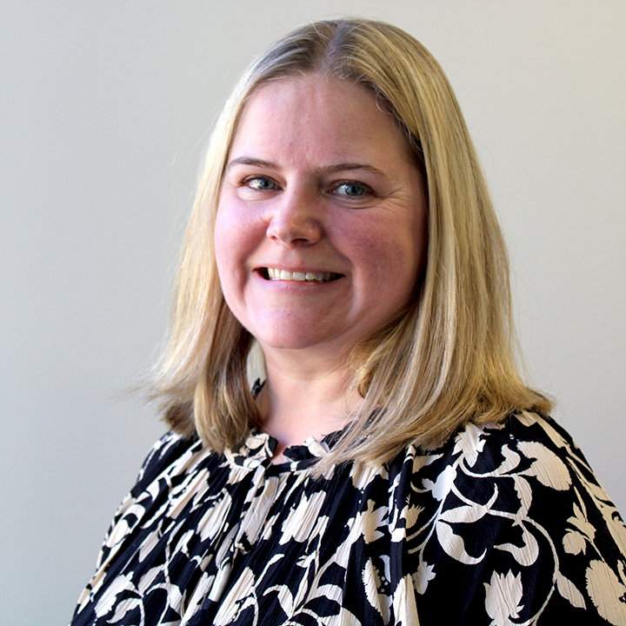


Hennepin County Ryan White HIV Services Team
Alissa Fountain
Ryan White Program Manager
Alissa.Fountain@Hennepin.us
Carissa Weisdorf
Lead HIV Services Planner
Carissa.Weisdorf@Hennepin.us
Cody Raasch
Ryan White Data Analyst
Cody.Raasch@Hennepin.us
Eriika Etshokin
Ryan White Grants Supervisor
Eriika.Etshokin@Hennepin.us
Hennepin County Ryan White Program
Subrecipient onboarding – Grant Overview

Slide 20


MCHACP is a community planning council formed in 2016 as a collaborative effort between the Minnesota Department of Human Services, Hennepin County Public Health, and the Minnesota Department of Health.
It is the responsibility of MCHACP to oversee the development, update, and monitoring of the Minnesota comprehensive jurisdictional plan for HIV prevention, care, and treatment; allocate federal Ryan White funds for Part A for HIV treatment and care services; make allocations recommendations to Part B for HIV treatment and care services; and prioritize populations for HIV prevention services.
More information and council vacancies can be found on the MCHACP Website.
Aamina Abdirashid Mohamed
Planning Council Coordinator
Aamina.AbdirashidMohamed@hennepin.us
Hennepin County Ryan White Program
Subrecipient onboarding – Grant Overview

Slide 21

Quality Management
Reviews and advises on Quality Improvement Plan development and implementation
Offers annual training on quality management
Plans and conducts Site Visits with HIV Services Team
Reviews Quarterly Reports
Facilitates Quality Management Advisory Committee (QMAC) and virtual Quality Learning Committee (QLC) on Basecamp
Identifies need for and facilitates Technical Advisor/Training
Scott Bilodeau
Quality Management
Coordinator
Scott.Bilodeau@Hennepin.us

Slide 22

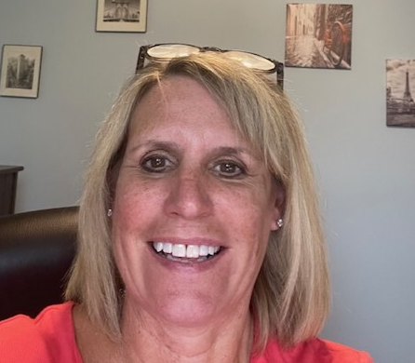
Contracts & Invoices
Contracts
Providers are required to report any key staff changes and the transition plan to the contract manger within 5 days of change.
Hennepin County Ryan White Program contract guide is available online for contracted service providers.
Questions about specific contract or invoice processes may be directed to the Ryan White Program Officer.
Invoices
Invoices are due to your Project Officer by the 15th of the month following service delivery.
Invoices must match the services and number of clients served in CAREWare.
Discrepancies may cause delay in invoice processing and payment.
Invoice amounts are tracked to be sure the service budget is not exceeded.
Jeremy Stadelman
Program Officer
Jeremy.Stadelman@Hennepin.us
Jacki Gould
Contract Manager
Jacki.Gould@Hennepin.us

Slide 23


Brenda Senyana
Positively Hennepin Implementation Coordinator
Brenda.Senyana@Hennepin.us
Background:
In 2010, the National HIV/AIDS Strategy was issued.
In 2016, Positively Hennepin, Hennepin County’s strategy to end the local HIV epidemic, was developed and implemented to align with national efforts.
In 2021, Positively Hennepin was updated.
Vision:
All people living with HIV/AIDS have healthy, vibrant lives.
There are no new HIV infections.
All people have equitable access to HIV prevention and health care services.
Goals:
Decrease new HIV Infections
Ensure access to and retention in care
Engage & facilitate the empowerment of communities disproportionately affected by HIV to stop new infections and eliminate disparities
Operating Principles:
Reduce health disparities and promote health and racial equity
Achieve a fully integrated public and private response to the epidemic
Hennepin County Ryan White Program
Subrecipient onboarding – Grant Overview

Slide 24

Ryan White Program Team Contacts
Team Member | Email Address | Area(s) of Expertise
Aamina Abdirashid Mohamed | aamina.abdirashidmohamed@hennepin.us | Minnesota Council for HIV/AIDS Care & Prevention
Alissa Fountain | alissa.fountain@hennepin.us | Statewide HIV/AIDS Initiatives, Ryan White Grant Administration, Data
Brenda Senyana (she/her) | brenda.senyana@hennepin.us | Positively Hennepin, Status Neutral Approach Grant, PrEP Network, Rapid StART
Carissa Weisdorf (she/her) | carissa.weisdorf@hennepin.us | HIV Services, Grant Administration, Annual Site Visits, Centralized Eligibility
Cody Raasch (he/him) | cody.raasch@hennepin.us | Data, CAREWare, Technical Assistance
Eriika Etshokin (she/her) | eriika.etshokin@hennepin.us | HIV Services, Grant Administration, Centralized Eligibility
Jacki Gould (she/her) | jacki.gould@hennepin.us | Contracts, Invoicing, Budgets
Jeremy Stadelman (he/him) | jeremy.stadelman@hennepin.us | Contracts, Invoices, Allowable Expenses, Service Standards
Scott Bilodeau (he/him) | scott.bilodeau@hennepin.us | Quality Management, Quality Improvement Plans
Hennepin County Ryan White Program
Subrecipient onboarding – Grant Overview

Slide 25

Minnesota Systems/Resources
System | Access | Administrator | Purpose
Basecamp | https://launchpad.37signals.com/basecamp/1096789/signin | Hennepin County | Quality Learning Committee, Centralized Eligibility Communications, other projects
CAREWare | https://mncw.dhs.state.mn.us/careware/rs/index.htm | MDH | Logging Ryan White Services rendered
CAREWare SharePoint | https://mn365.sharepoint.com/sites/MDH/careware/SitePages/Home.aspx | MDH | CAREWare Support and Guidance
Data Dashboard | https://app.powerbigov.us/view?r=eyJrIjoiOGUzNDNkMjItNWFiZS00NjU2LTkzMzAtMTZlNGQ2ODU1MTc5IiwidCI6IjhhZWZkZjlmLTg3ODAtNDZiZi04ZmI3LTRjOTI0NjUzYThiZSJ9 | Hennepin County | Qualitative data on service and expenditure data
DHS HIV Services Webpage | https://mn.gov/dhs/people-we-serve/adults/health-care/hiv-aids/programs-services/ | DHS | Ryan White Eligibility Application Information and Online Submission, Program HH Information
Hennepin County Webpage | http://hennepin.us/ryan-white | Hennepin County | Ryan White Grant Overview and Provider/Consumer Guidance
MCHACP Webpage | https://www.mnhivcouncil.org/ | Hennepin County | Minnesota Council for HIV/AIDS Care & Prevention Information, Meeting Minutes, Recruitment, Service Standards, etc.
MN Portal/At-A-Glance | https://mnce.dhs.state.mn.us/ | MDH | Verifying Ryan White client eligibility
Hennepin County Ryan White Program
Subrecipient onboarding – Grant Overview

Slide 26

External Ryan White Resources
Resource | Access | Purpose
Part A Manual | https://ryanwhite.hrsa.gov/sites/default/files/ryanwhite/resources/manual-part.pdf | The Parts A and B Manuals serve as orientation guides for Ryan White Part A covering key issues and strategies to broaden access to HIV care and treatment, legislative, grant, and program requirements, fiscal considerations, planning council operations, and technical assistance information.
Part B Manual | https://ryanwhite.hrsa.gov/sites/default/files/ryanwhite/resources/hab-part-b-manual.pdf
National Monitoring Standards Part A | https://www.hennepin.us/-/media/hennepinus/business/work-with-hennepin-county/ryan-white/national-monitoring-standards-part-a.pdf | Issued from the Health Resources and Service Administration's HIV/AIDS Bureau, the National Monitoring Standards for Part A recipients includes resources for Parts A and B recipients and subrecipients in meeting federal requirements for program and fiscal management, monitoring, reporting, and oversight of the program.
National Monitoring Standards Part B | https://www.hennepin.us/-/media/hennepinus/business/work-with-hennepin-county/ryan-white/national-monitoring-standards-part-b.pdf
Policy Clarification Notice 16-02 | https://www.hennepin.us/-/media/hennepinus/business/work-with-hennepin-county/ryan-white/ryan-white-service-providers.pdf | The PCN #16-02 outlines eligible individuals, service category descriptions and program guidance, and allowable expenses within service categories.
Policy Clarification Notice 21-02 | https://ryanwhite.hrsa.gov/sites/default/files/ryanwhite/grants/pcn-21-02-determining-eligibility-polr.pdf | The PCN #21-02 outlines guidance for determining client eligibility and complying with the payor of last resort requirement.
Code of Federal Regulations, Part 75 | https://www.ecfr.gov/current/title-45/subtitle-A/subchapter-A/part-75 | Provides uniform administrative requirements, cost principles, and audit requirements for all HHS awards.

